Slide 1

Kannada Speech Recognition
BY,
Rishi Kumar PS 1MS16CS078
Darshan Konnur 1MS17CS026
Sathvik KP 1MS17CS143
Priya S 1MS17CS146

Slide 2
Introduction
Speech Recognition is the ability of a machine or program to identify words or phrases in spoken language and convert them to a machine readable format.
Developing a speech recognition system in Kannada is necessary as this can be of great use in providing subtitles to educational videos, historical videos, news, reports, speeches, debates etc.,

Slide 3
Problem Statement
The absence of a free program or a system which effectively provides transcripts to a video or audio file in Kannada Language is a major issue. If such transcripts have to be provided, then a human has to manually provide them. This is very labor intensive job and majorly ineffective. Hence the lack and availability in the development of an effective speech recognition system is Kannada is the concerned problem.

Slide 4
Objectives
The objective of the project is to develop a speech recognition system which can detect words in Kannada language from an audio input file.
Such a free system is absent for this language.

Slide 5
Overview
The Hidden Markov Model Toolkit (HTK) is a portable toolkit for building and manipulating hidden Markov models.
HTK is primarily used for speech recognition research although it has been used for numerous other applications including research into speech synthesis, character recognition and DNA sequencing.
Why HTK over other models?

Slide 6
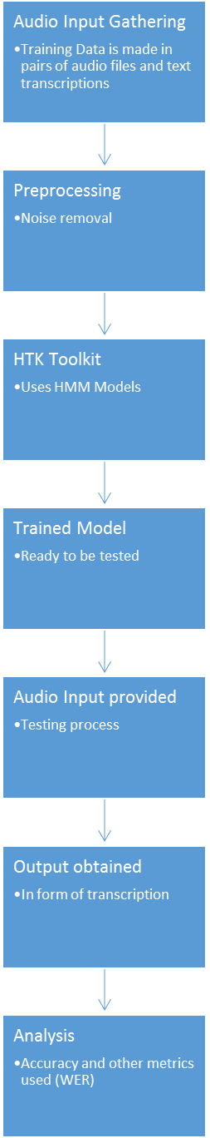
Flow Diagram

Slide 7
Dataset Preparation
7 speakers were chosen
30 sentences were chosen for utterances
Around 150 words were extracted
7x30=210 utterances were used to train and test
Altogether 30 utterances were chosen from all the speakers for testing
Rest 180 utterances were used to train the model

Slide 8
Dataset Pre-processing
Recorded all the utterances of the speakers using Audacity.
At 16KHz sample rate
In .wav format (lossless)
Transcription written in Kannada in txt format
Transcription file was then transliterated into ILSL format
Around 150 unique words were taken from the transcription
Sorted all the words

Slide 9
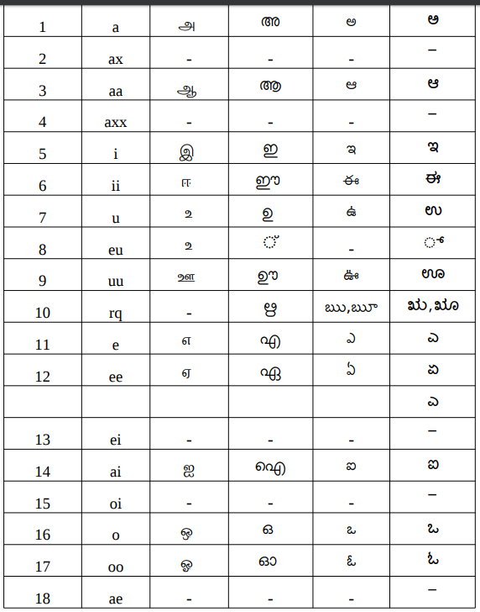
Dataset Pre-processing
…Continued
Each word was then lexiconised at phone and word level
And then created dictionary, wordnet and bigram files

Slide 10
HTK Functions Used
HTK provides different libraries for pre-processing, building models and evaluation

Slide 11
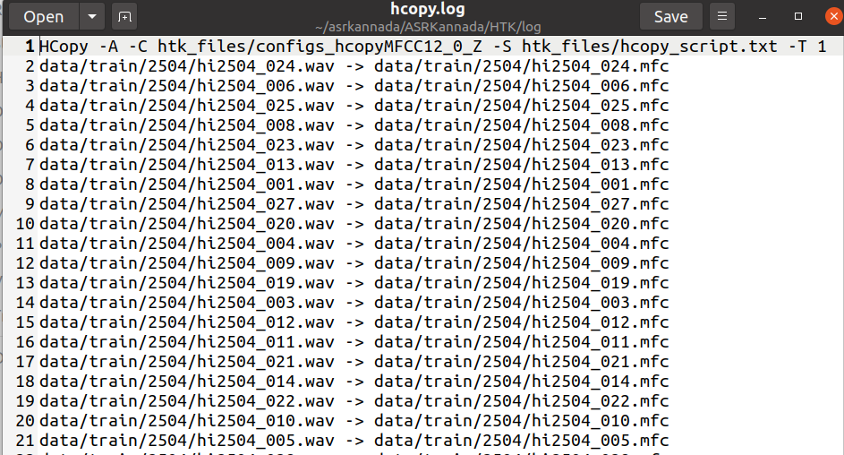
master.sh HCOPY
Feature extraction from wav data, calls inbuilt HTK library HCopy
Creates .mfc files from .wav files

Slide 12
master.sh LEXICON
Creates the following
Transcriptions (using perl scripts)
Master Label Files at phone level and word level (HLed)
Bigram grammar files (LNewMap, LGPrep, LGCopy, LBuild and HBuild)
lists of symbols (monophones0 and monophones1)
Basically, builds the language model using inbuilt HTK Functions such as HBuild, HParse, HDman

Slide 13
master.sh HCOMPV
Flat start initialisation of hmm variables such as mean and variance
We have used 10 hmm models in our project
Calls inbuilt HTK Functions HCompv

Slide 14
master.sh HEREST
Calls inbuilt HTK function HErest
Is the core part of the project
Performs Baum Welch Re-Estimation to re-estimate parameters of HMM models initialised earlier using HCompv
Takes into consideration mfc files and language model created

Slide 15
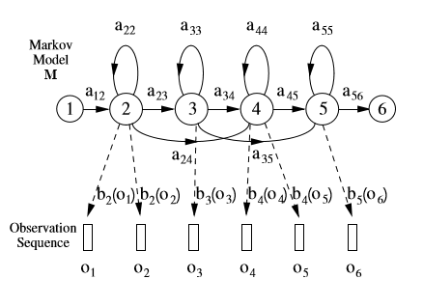
a: probablity; b(o): density function with occurence o; 1,2,3.. : States

Slide 16
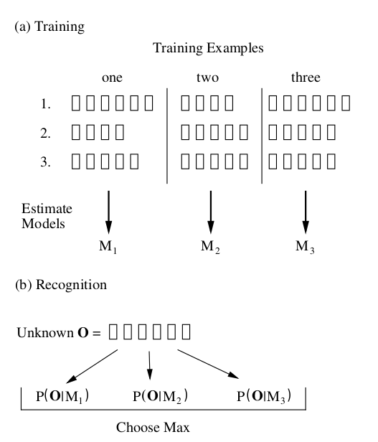

Slide 17
master.sh ALIGN
Calls inbuilt function hviteAlign which realigns the training data using HMMs created so far and it creates new transcriptions (with best pronunciation [out of many alternatives] for each recognised word) for aligned/training data.
This is done by HTK to improve the accuracy of the model

Slide 18
master.sh HVITE_MONO
Is used for testing purposes
Invokes HCopy for test data to extract features
Then calls HResult (In-built HTK Library) to provide results of testing process
Shows accuracy, word substitutions, insertions and deletions
Demo for just one sample can be accomplished by calling master.sh DEMO

Slide 19
Testing
The data is split into training data and test data
Data, lexicon and transcriptions, HTK libraries and scripts are placed in project directory
Commands are run
Results obtained

Slide 20
Results
SENT: %Correct=50.00 [H=14, S=14, N=28]
WORD: %Corr=83.64, Acc=72.73 [H=138, D=3, S=24, I=18, N=165]

Slide 21
Conclusion
We have found that speech recognition using Hidden Markov Models(HMM) produce good acceptable results and fare better when compared to other machine learning models which involve time series. HTK is an excellent tool for speech recognition and automates most of the process. It is possible to make an acceptable speaker independent recognition system for any language using HTK Tools provided sufficient grammatically rich dataset is available.
One important conclusion is that phone level decomposition of words is vital for speech recognition. This is different for different languages and hence, different models have to be trained for different languages. Decomposition into phones is no easy task for any language and it involves a tremendous amount of work.
Another conclusion is prevalence of word spacing and silence in continuous speech recognition. Silence and spacing have to be given importance while training the model to correctly predict the words in order to avoid conjugation at phone levels. Thus, giving different words.
Some suggestions are usage of huge amounts of grammatically rich data with accurate transcriptions and phone level lexicon dictionaries will generate a good recognition system. The data should avoid silences and word spacing must be proper. All the audio files should have a similar sampling rate.

Slide 22
Significance of the proposed Research Work
Speech recognition is still a domain which is yet to be completely explored. There are hundreds of languages across the world which do not have a proper Automatic Speech Recognition System. Kannada is one such language which does not have easily available ASR systems. The System developed by us has helped us with knowledge on how to build a better system and the steps in order to achieve it. We also have the results which are satisfactory and can be of great help to other researchers trying to achieve the same purpose.

Slide 23
Limitations of this Research Work
One significant limitation of our project is that the transcript generated is of Indian Language Speech sound Label set (ILSL) format. It has to be converted into UTF-8. This encoding is not always accurate and can lead to a lot of errors.
Another limitation is converting UTF-8 to ILSL in the first place for training. There are no reliable encoding systems readily available for this purpose. The same applies to phone level decomposition. It is difficult to do it for Kannada in ILSL format as there are not many resources available. We achieved this manually which is a very time consuming process.
A minor limitation is the amount of data considered. Due to not getting a good dataset, we had to manually create our own dataset. Thus, less amount of data was used for training. However, the advantage of this is that we were able to create the highest quality data without errors and thus, the ASR system worked very well.
Connection with a real time application is also difficult due to the nature of HTK.

Slide 24
Direction and Scope for the Future Work
Proper pre-processing of data must be taken care of. This involves transliteration into ILSL format. A proper way to convert data into this format without errors has to be proposed. Phone level decomposition is also a huge task and more efficient ways to achieve this must be developed.
ASR systems can be extended to other real time applications such as video software to provide real time transcriptions. The same can be applied for audio without video. The integration of ASR Systems into real time applications must be developed.

